Slide 1
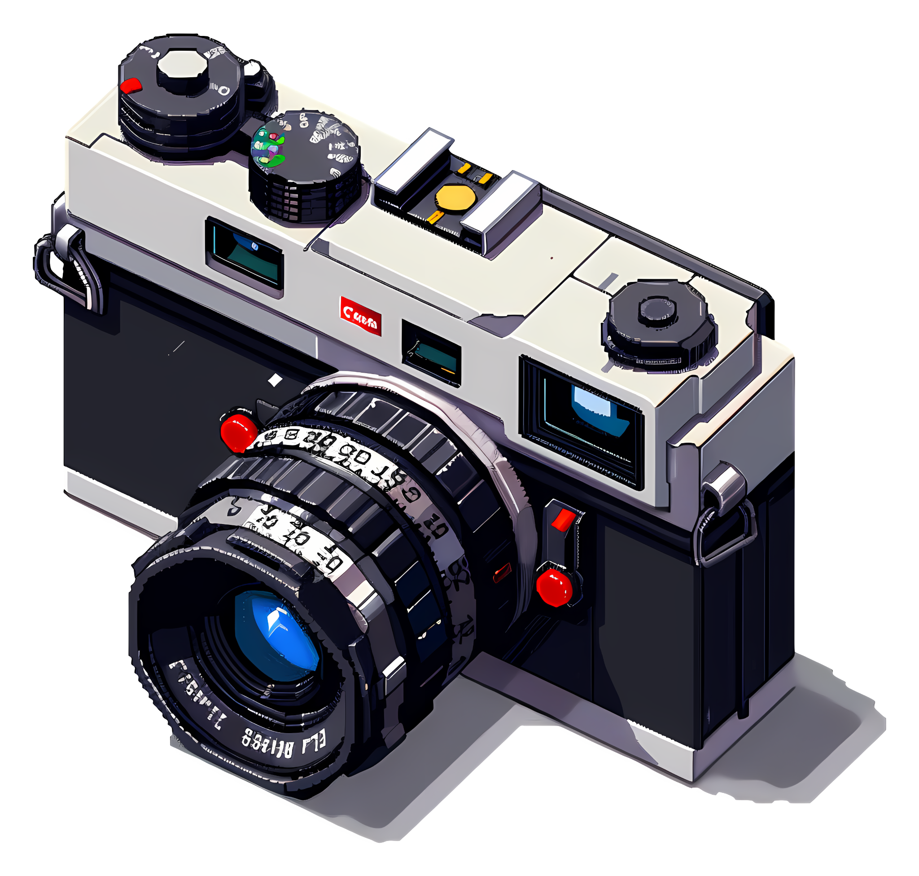
GAZE DETECTION
RELEVANCE
FIRST MODEL
PROGRESS/FIXES
FINAL MODEL
CONCLUSIONS
Achinthya Sreedhar, Aryan Sehgal, Barrett Ratzlaff, Neha Shastri

Slide 2
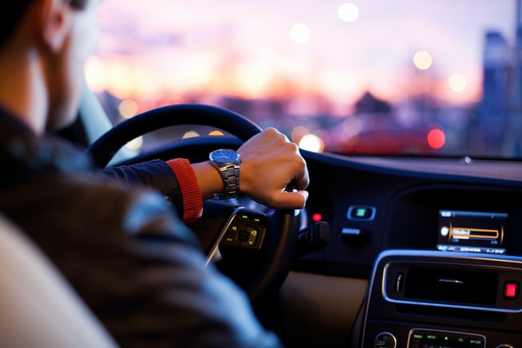



RELEVANCE
FIRST MODEL
PROGRESS/FIXES
FINAL MODEL
CONCLUSIONS
Gaze Detection has utility in many spaces

Slide 3
RELEVANCE
FIRST MODEL
PROGRESS/FIXES
FINAL MODEL
CONCLUSIONS
Each application has a different range of interest for a user’s gaze
For the scope of our project, we chose a binary label classification: Is the user looking directly at the camera, or not?

Slide 4
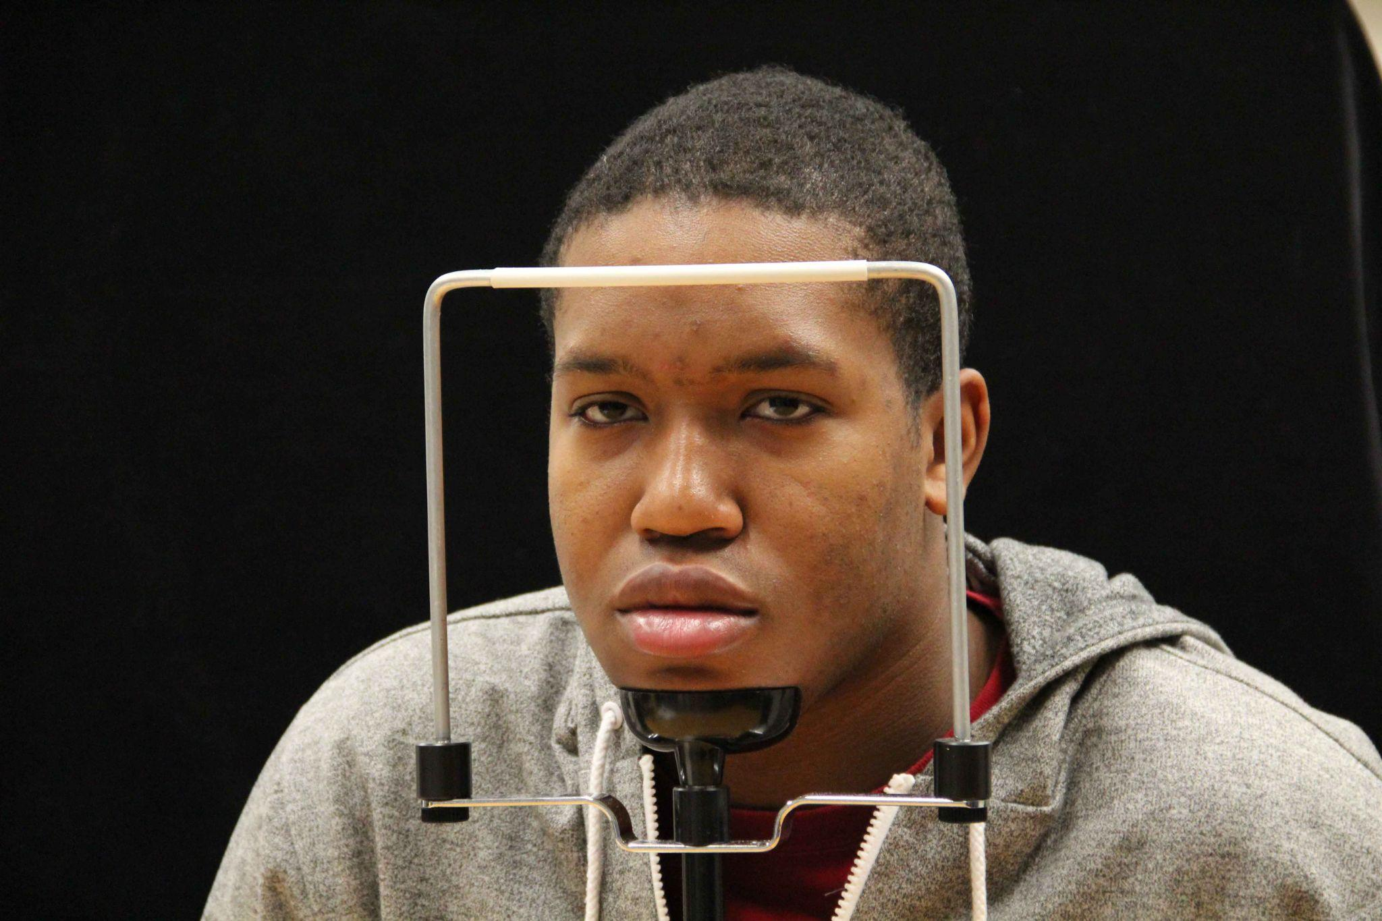
RELEVANCE
FIRST MODEL
PROGRESS/FIXES
FINAL MODEL
CONCLUSIONS
Example:
Our dataset comes from Columbia University, in which there are 5,880 headshot photos of 56 diverse subjects taken at various angles.
Our dataset has a significant class imbalance, with ~720 photos of subjects looking at the camera, and the remaining 5,000 photos in the null class based on our initial standard.

Slide 5
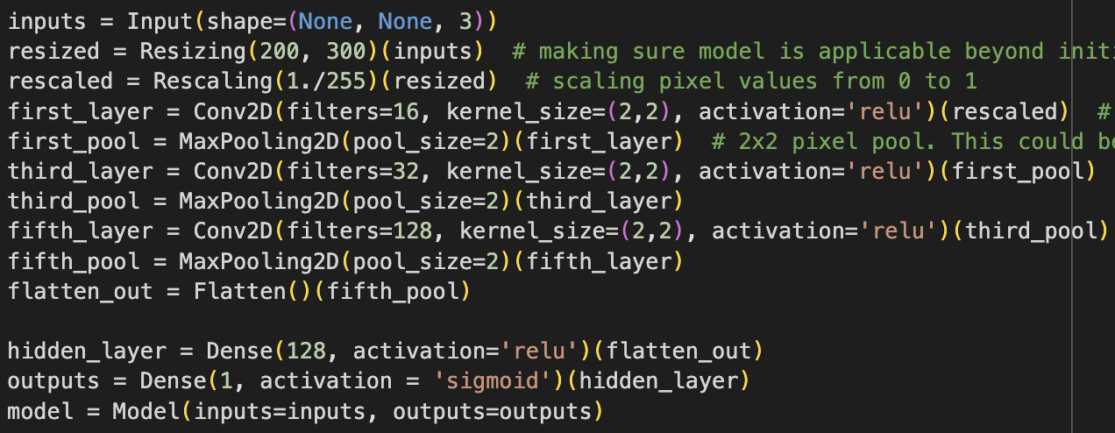
RELEVANCE
FIRST MODEL
PROGRESS/FIXES
FINAL MODEL
CONCLUSIONS
After layers to resize abnormal images to a standard size, our initial model had three convolutional layers, increasing in filters with each layer. Between each Conv2D layer was a MaxPooling layer.

Slide 6
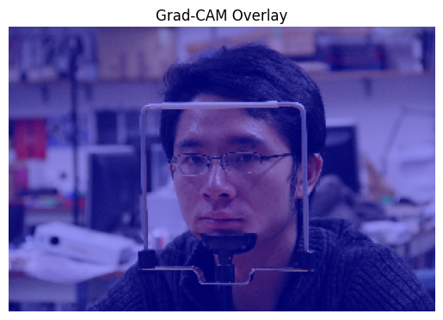
RELEVANCE
FIRST MODEL
PROGRESS/FIXES
FINAL MODEL
CONCLUSIONS
FIRST MODEL
After training, we found that our model had ~87% accuracy on the validation set! However…
While our model was learning on the training set, it was invariably predicting the null class on any validation/test set.

Slide 7
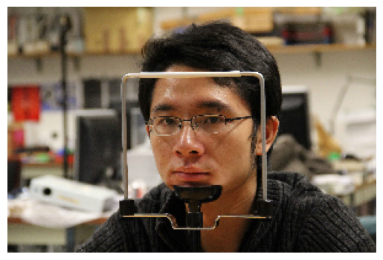
RELEVANCE
FIRST MODEL
PROGRESS/FIXES
FINAL MODEL
CONCLUSIONS
1 of 728 positive class photos
Part of the trouble is the extra details in the photo.

Slide 8
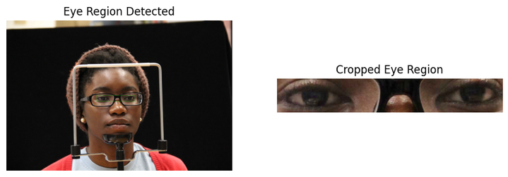
RELEVANCE
FIRST MODEL
PROGRESS/FIXES
FINAL MODEL
CONCLUSIONS
To reduce the noise any one photo introduces to our model, we implemented Mediapipe to crop the photos before prediction:
To improve performance, we added MobileNet on top of our base architecture.

Slide 9
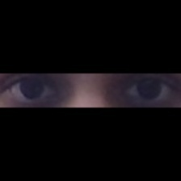
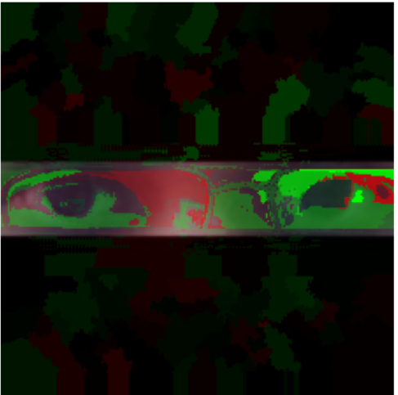
Overfitting!
RELEVANCE
FIRST MODEL
PROGRESS/FIXES
FINAL MODEL
CONCLUSIONS
Notes:
On the left we have the input image to the model and on the right is the same image with the lime explanation map the model uses to make the prediction on top . The parts in green is what helped the model determine a positive class prediction while the red parts are for the opposite. There’s a couple of problems here. 1. There are some green and red patches on the black background area. This means that the model is not exclusively focussing on the areas we want it to. 2. You can see a faint outline of glassesin the image on the right, but our subject here is not wearing any glasses. This is a clear sign of overfitting and our model has now learnt to recognize if someone is wearing glasses instead of if they are looking at the camera.

Slide 10
RELEVANCE
FIRST MODEL
PROGRESS/FIXES
FINAL MODEL
CONCLUSIONS
After testing 8 different adjustments individually to see how the model addressed overfitting, we found that:
Improving Data
Improving Model
Data Augmentation
Gaussian Noise
Class Weights
Drop-out Layers
L2 Regularization
Threshold Adjustment
All resulted in marginal improvements in the model’s precision. We were most interested in the model’s ability to predict the positive class.
Notes:
To overcome overfitting, we tried 8 different adjustments and came up with a two pronged approach. On one hand, we improved the input data using data augmentation - meaning randomly flipping, zooming or adjusting brightness and contrast. Gaussian noise, which adds random minor fluctuations in color or brightness in the image. We also used custom class weights, giving a proportionately higher priority to the positive class as compared to the negative. On othe other hand, we improved our model, using drop out layers and L2 regularization to combat overfitting directly. We also adjusted the probability threshold to predict the positive class in the end, helping our model improve performance on the positive class.

Slide 11
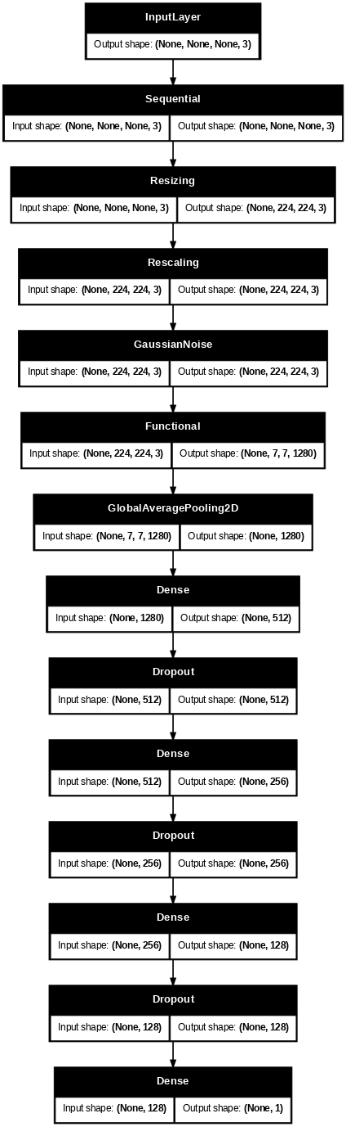
Preprocessing
FINAL MODEL ARCHITECTURE
Classification Head
MobileNet
Notes:
Going over our final model architecture, it’s split into 3 main parts. First is the preprocessing, including resizing, scaling and gaussian noise. This leads into the mobilenet pretrained model. This is followed by a global average pooling layer to maintain spatial features. And this leads to our final classification head, which involved 3 blocks of dense and dropout layers followed by a final dense layer to make the prediction.

Slide 12
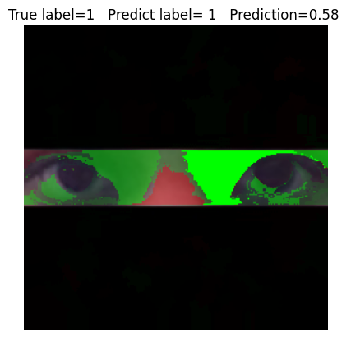
RELEVANCE
FIRST MODEL
PROGRESS/FIXES
FINAL MODEL
CONCLUSIONS
The highlighted area includes both eyes and the nose bridge, suggesting the model may have learned that eye alignment and facial symmetry are important cues for gaze detection.
Notes:
With all of our changes, here is the lime explanation map from our final model over the same image. We see that the model is no longer focussing on the background and instead identifying the features that matter, in this case the whites of the eye and the space between the eyes and nose. Intuitively, this makes sense as when you’re facing away from the camera, the distance between the eye and nose is less as compared to looking straight ahead, where the same distance is more.

Slide 13
Progression Made
RELEVANCE
FIRST MODEL
PROGRESS/FIXES
FINAL MODEL
CONCLUSIONS
Base | Predicted - | Predicted +
Actual - | 773 | 00
Actual + | 110 | 00
Intermediate | Predicted - | Predicted +
Actual - | 430 | 343
Actual + | 36 | 74
Mediapipe
MobileNet
Final | Predicted - | Predicted +
Actual - | 268 | 496
Actual + | 28 | 152
Deeper Model
Fine Tuning

Slide 14
Failures & Learnings
RELEVANCE
FIRST MODEL
PROGRESS/FIXES
FINAL MODEL
CONCLUSIONS
Face/ Eye detection Models Tested
Haar Cascades
Mediapipe (Iris Detection)
Face Alignment
Dlib
Insightface
Pre-Trained Models Tested
DenseNet
EfficientNet
ResNet
Additional Techniques Tested
Random blur
Random blackout
Label smoothening
Other loss functions
Oversampling Minority Class

Slide 15
Say Cheese!
RELEVANCE
FIRST MODEL
PROGRESS/FIXES
FINAL MODEL
CONCLUSIONS

Slide 16
RELEVANCE
FIRST MODEL
PROGRESS/FIXES
FINAL MODEL
CONCLUSIONS
CONCLUSIONS
Results
Next steps
Compared several cropping methods, backbone architectures and regularization strategies to arrive at a model balancing speed and accuracy
Real-time face detection works reliably but gaze prediction lags in the live demo. By allocating more computational power and increased development time, we can fine tune the model to perform even better on webcam quality data.

Slide 17
Thank You!
Questions?

